Slide 1
Basic Logic Gate Design

Slide 2
Basic Logic Gate Design
INTRODUCTION
TYPES OF LOGIC GATES
CONCLUSION

Slide 3
INTRODUCTION
Logic gates are the basic building blocks of digital electronic systems. They perform logical operations on one or more binary inputs (0 and 1) to produce a single binary output. Every digital device, such as computers, calculators, smartphones, and communication systems, uses logic gates to process and control data.
The fundamental logic gates are AND, OR, and NOT, while NAND, NOR, XOR, and XNOR are derived gates with specialized functions. Understanding these gates is essential for designing digital circuits and developing modern electronic systems.
This project explains the symbols, truth tables, working principles, and practical applications of basic logic gates.

Slide 4
TYPES OF LOGIC GATES:
There are 3 types of logic gates:
Basic Gates : OR, AND, and NOT Gates.
Universal Gates : NAND, and NOR Gates.
Derived Gates : XOR Gates, and XNOR Gates.

Slide 5
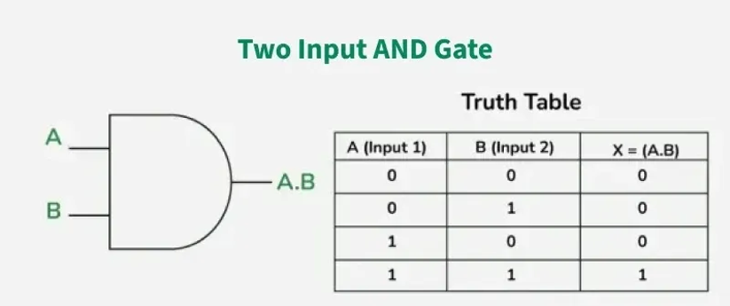
AND GATE
An AND gate is a basic digital logic gate that produces a HIGH (1) output only when all of its inputs are HIGH (1). If any input is LOW (0), the output is LOW (0).
Boolean Expression: Y = A · B
Applications:
Digital circuits
Decision-making logic
Security and alarm systems
Computer processors

Slide 6
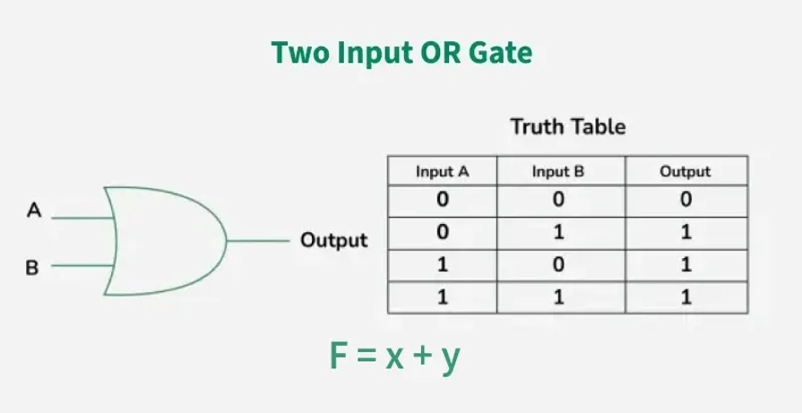
OR GATE
An OR gate is a basic logic gate that produces a HIGH (1) output if at least one input is HIGH (1). The output is LOW (0) only when all inputs are LOW (0).
Boolean Expression: Y = A + B
Applications:
Alarm systems
Decision-making circuits
Control systems

Slide 7
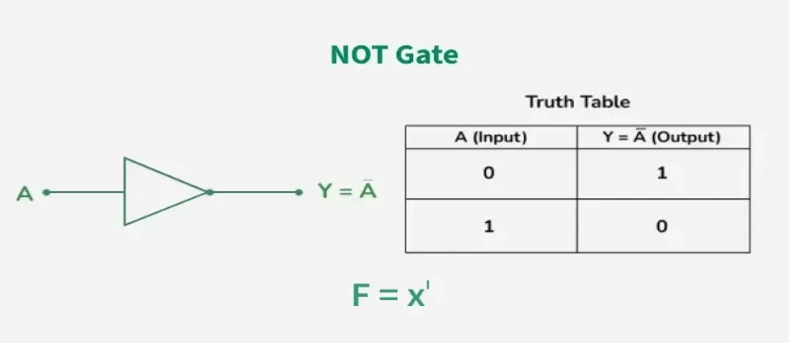
NOT GATE
A NOT gate (Inverter) produces the opposite of its input. It converts 1 to 0 and 0 to 1.
Boolean Expression: Y = A'
Applications:
Signal inversion
Digital switching
Memory circuits

Slide 8
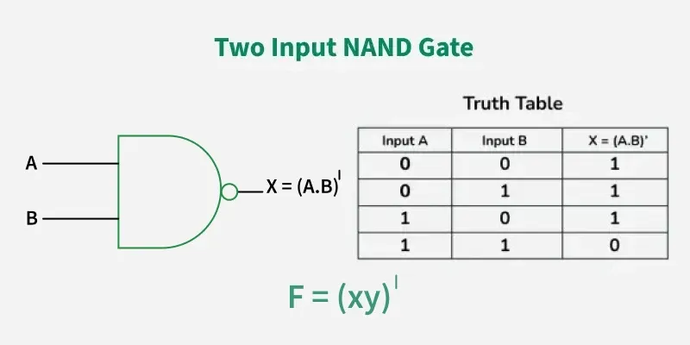
NAND GATE
A NAND gate is the complement of the AND gate. It gives a LOW (0) output only when all inputs are HIGH (1).
Boolean Expression: Y = (A · B)'
Applications:
Universal logic gate
Digital circuit design
Flip-flops

Slide 9
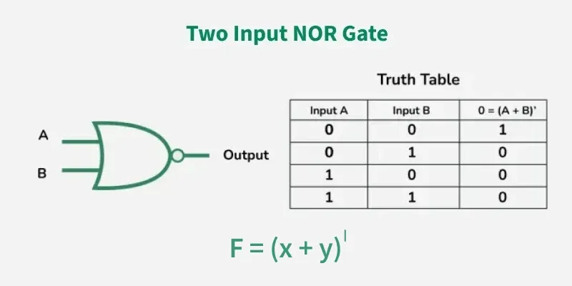
NOR GATE
A NOR gate is the complement of the OR gate. It gives a HIGH (1) output only when all inputs are LOW (0).
Boolean Expression: Y = (A + B)'
Applications:
Universal logic gate
Memory circuits
Control systems

Slide 10
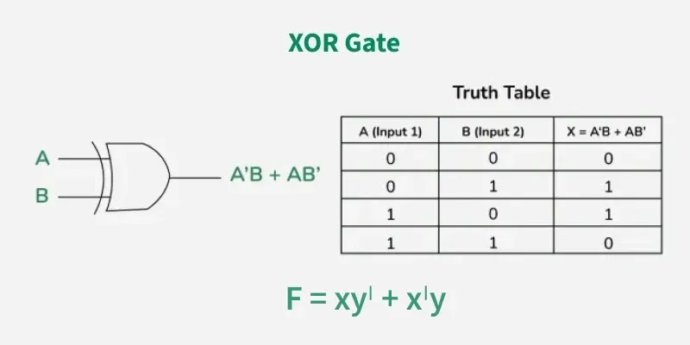
XOR GATE
An XOR (exclusive OR) gate produces a HIGH (1) output when the inputs are different.
Boolean expression: Y = A ⊕ B
Applications:
Binary addition
Error detection
Comparators

Slide 11
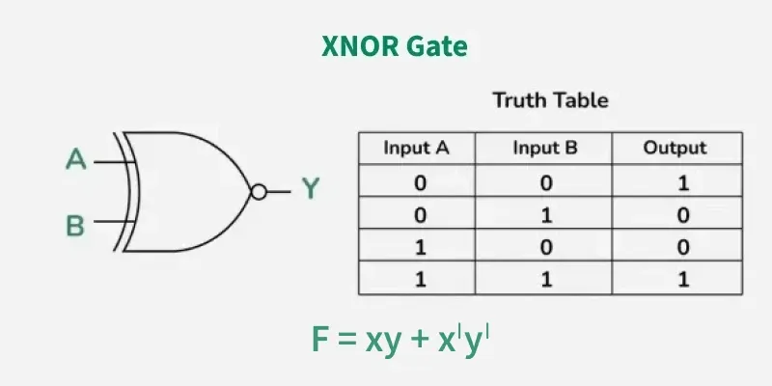
XNOR GATE
An XNOR gate produces a HIGH (1) output when the inputs are the same.
Boolean Expression: Y = (A ⊕ B)'
Applications:
Equality checking
Digital comparators
Error detection

Slide 12
CONCLUSION
Basic logic gates are the foundation of all digital electronic systems. Understanding the operation, truth tables, and applications of AND, OR, NOT, NAND, NOR, XOR, and XNOR gates is essential for designing digital circuits. These gates are widely used in computers, communication systems, embedded systems, and modern electronic devices.

Slide 13
THANK YOU

